Slide 1
Design of Algorithms
Computer Science, Purdue University
Copyright McGraw Hill, Rosen, Discrete Mathematics and its Applications

Slide 2
Design of Algorithms
Brute Force Algorithms
A brute-force algorithm is solved in the most straightforward manner, without taking advantage of any ideas that can make the algorithm more efficient.
Brute-force algorithms we have previously seen are sequential search, bubble sort, and insertion sort.
Computer Science, Purdue University

Slide 3
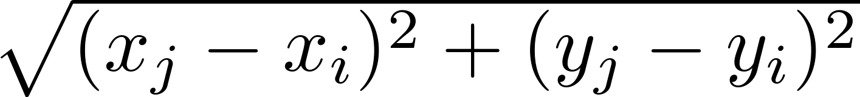
Design of Algorithms
Brute Force Algorithms: Computing the Closest Pair of Points
Example: Construct a brute-force algorithm for finding the closest pair of points in a set of n points in the plane and provide a worst-case estimate of the number of arithmetic operations.
Solution: Recall that the distance between (x_{i},y_{i}) and (x_{j}, y_{j}) is A brute-force algorithm simply computes the distance between all pairs of points and picks the pair with the smallest distance.
Computer Science, Purdue University

Slide 4
Design of Algorithms
Brute Force Algorithms: Computing the Closest Pair of Points
Algorithm for finding the closest pair in a set of n points.
The algorithm loops through n(n −1)/2 pairs of points, computes the value (x_{j} − x_{i})² + (y_{j} − y_{i})² and compares it with the minimum, etc. So, the algorithm uses Θ(n²) arithmetic and comparison operations.
procedure closest pair((x₁, y₁), (x₂, y₂), … ,(x_{n}, y_{n}): x_{i}, y_{i} real numbers)
min = ∞
for i := 1 to n
for j := 1 to i
if (x_{j} − x_{i})² + (y_{j} − y_{i})² < min
then min := (x_{j} − x_{i})² + (y_{j} − y_{i})²
closest pair := (x_{i}, y_{i}), (x_{j}, y_{j})
return closest pair
Computer Science, Purdue University

Slide 5
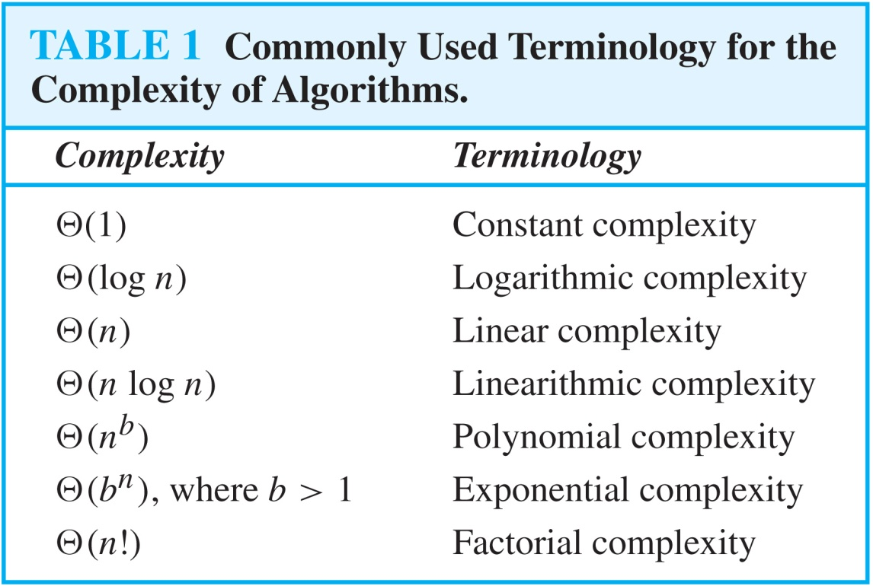
Design of Algorithms
Understanding the Complexity of Algorithms
Computer Science, Purdue University

Slide 6
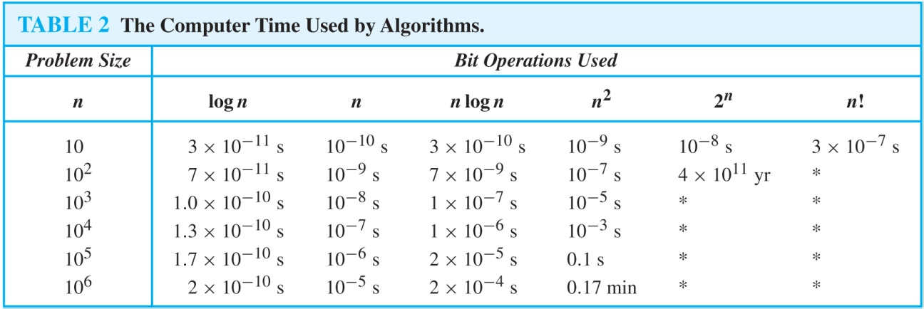
Design of Algorithms
Understanding the Complexity of Algorithms
Times of more than 10¹⁰⁰ years are indicated with an *.
Computer Science, Purdue University

Slide 7
Design of Algorithms
Complexity of Problems
Tractable Problem: There exists a polynomial time algorithm to solve this problem. These problems are said to belong to the Class P.
Intractable Problem: There does not exist a polynomial time algorithm to solve this problem
Unsolvable Problem : No algorithm exists to solve this problem, e.g., halting problem.
Class NP: Solution can be checked in polynomial time. But no polynomial time algorithm has been found for finding a solution to problems in this class.
NP Complete Class: If you find a polynomial time algorithm for one member of the class, it can be used to solve all the problems in the class.
Computer Science, Purdue University

Slide 8
Design of Algorithms
P vs. NP
The P versus NP problem asks whether the class P = NP? Are there problems whose solutions can be checked in polynomial time, but can not be solved in polynomial time?
Note that just because no one has found a polynomial time algorithm is different from showing that the problem can not be solved by a polynomial time algorithm.
If a polynomial time algorithm for any of the problems in the NP complete class were found, then that algorithm could be used to obtain a polynomial time algorithm for every problem in the NP complete class.
Satisfiability is an NP complete problem.
It is generally believed that P≠NP since no one has been able to find a polynomial time algorithm for any of the problems in the NP complete class.
The problem of P versus NP remains one of the most famous unsolved problems in mathematics (including theoretical computer science).
Computer Science, Purdue University

Slide 9
Thank You

